Slide 1




FAKE NEWS DETECTION
Shri Vaishnav Vidyapeeth Vishwavidyalaya
Shri Vaishnav Institute of Information Technology
Department of Computer Science & Engineering
Project Guide: Submitted by:
Mr. Chetan Verma Aditi Sharma Arnav Sengar
Mr. Sumit Nigam Akshat Gawshinde Ujjwal Thakre
18100BTCSICS02994
18100BTCSICS02996
18100BTCSICS02998
18100BTCSICS03043

Slide 2


INDEX
Abstract
Introduction
Literature review
Problem statement
Objective
Requirement Analysis
Testing
Implementation
References

Slide 3
ABSTRACT
The advent of the World Wide Web and the rapid adoption of social media platforms (such as Facebook and Twitter) paved the way for information dissemination that has never been witnessed in human history before. With the current usage of social media platforms, consumers are creating and sharing more information than ever before, some of which are misleading with no relevance to reality. In this work, we propose to use a machine learning ensemble approach for automated classification of news articles. The extensive spread of fake news has the potential for extremely negative impacts on individuals and society. Therefore, fake news detection on social media has recently become an emerging research that is attracting tremendous attention. . It is how we would implement our fake news detection project in Python. It is another one of the problems that are recognized as a machine learning problem.

Slide 4
INTRODUCTION
The term “Fake News” was a lot less unheard of and not prevalent a couple of decades ago but in this digital era of social media, it has surfaced as a huge monster. Fake news, information bubbles, news manipulation and the lack of trust in the media are growing problems within our society. . However, in order to start addressing this problem, an in-depth understanding of fake news and its origins is required. Only then one can look into the different techniques and fields of machine learning (ML), natural language processing (NLP) and artificial intelligence (AI) that could help us fight this situation. “Fake news” has been used in a multitude of ways in the last half a year and multiple definitions have been given. For instance, the New York Times defines it as “a made-up story with an intention to deceive In its purest form, fake news is completely made up, manipulated to resemble credible journalism and attract maximum attention and, with it, advertising revenue. Despite all these shortcomings, several entities have tried to categorize fake news in different manners.

Slide 5
INTRODUCTION
These days’ fake news is creating different issues from sarcastic articles to fabricated news and planned government propaganda in some outlets. Fake news and lack of trust in the media are growing problems with huge ramifications in our society. Obviously, a purposely misleading story is “fake news “ but lately blathering social media’s discourse is changing its definition. Some of them now use the term to dismiss the facts counter to their preferred viewpoints.
The importance of disinformation within American political discourse was the subject of weighty attention , particularly following the American presidential election. The term 'fake news' became common parlance for the issue, particularly to describe factually incorrect and misleading articles published mostly for the purpose of making money through page views. In this paper, it is seeked to produce a model that can accurately predict the likelihood that a given article is fake news.

Slide 6
INTRODUCTION
Detecting fake news on social media poses several new and challenging research problems. The content of fake news is rather diverse in terms of topics, styles and media platforms, and fake news attempts to distort truth with diverse linguistic styles while simultaneously mocking true news. Thus, existing hand-crafted and data-specific textual features are generally not sufficient for fake news detection. Fake news is usually related to newly emerging, time-critical events, which may not have been properly verified by existing knowledge bases due to the lack of corroborating evidence or claims.
FUNCTIONALITY:
Detection of fake news
Watch Live news feeds
Retrieve trusted news sources

Slide 7
LITERATURE REVIEW
There exists a large body of research on the topic of machine learning methods for deception detection, most of it has been focusing on classifying online reviews and publicly available social media posts. Particularly since late 2016 during the American Presidential election, the question of determining 'fake news' has also been the subject of particular attention within the literature.
Fake news is not a new concept. Before the era of digital technology, it was spread through mainly yellow journalism with focus on sensational news such as crime, gossip, disasters and satirical news. The prevalence of fake news relates to the availability of mass media digital tools. Since anyone can publish articles via digital media platforms, online news articles include well researched pieces but also opinion-based arguments or simply false information.

Slide 8
LITERATURE REVIEW
A tool has been developed to identify fake news that spreads through social media through examining lexical choices that appear in headlines and other intense language structures.
Another tool, developed to identify fake news on Twitter, has a component called the Twitter Crawler which collects and stores tweets in a database. When a Twitter user wants to check the accuracy of the news found they can copy a link into this application after which the link will be processed for fake news detection. This process is built on an algorithm called the NER (Named Entity Recognition).

Slide 9
PROBLEM STATEMENT
Social media for news consumption is a double edged sword. On the one Hand, its low cost , easy access and rapid circulation of information lead people to consume news from social media. On the other Hand, it enables the wide spread of ‘fake news’ i.e. low quality news with intentionally false information. Therefore , Fake News detection on social media has recently become an appearing research that is attracting tremendous attention. Fake news detection on social media presents unique characteristics and challenges that make existing detection algorithms from traditional news media ineffective or not applicable. Fake news is intentionally written to mislead readers to believe false information.

Slide 10
OBJECTIVE
The main objective is to detect the fake news, which is a classic text classification problem with a straightforward proposition.
It is needed to build a model that can differentiate between “Real” news and “Fake” news.
User can watch live news feeds in the trending news section .
This is an attempt towards the upcoming Machine learning technology using which one can identify news as fake or real.
User can retrieve and read news from trusted news sources.

Slide 11
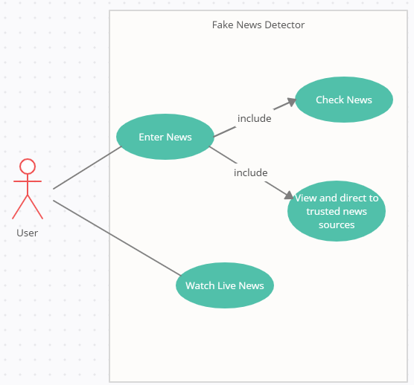
Use case Diagram

Slide 12
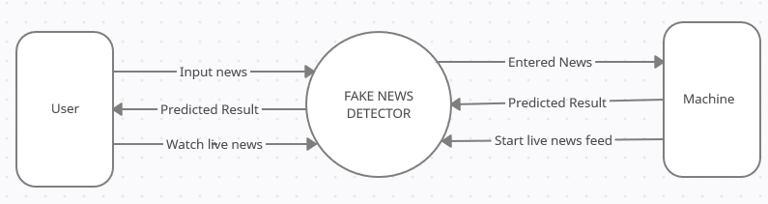
DFD Level 0

Slide 13
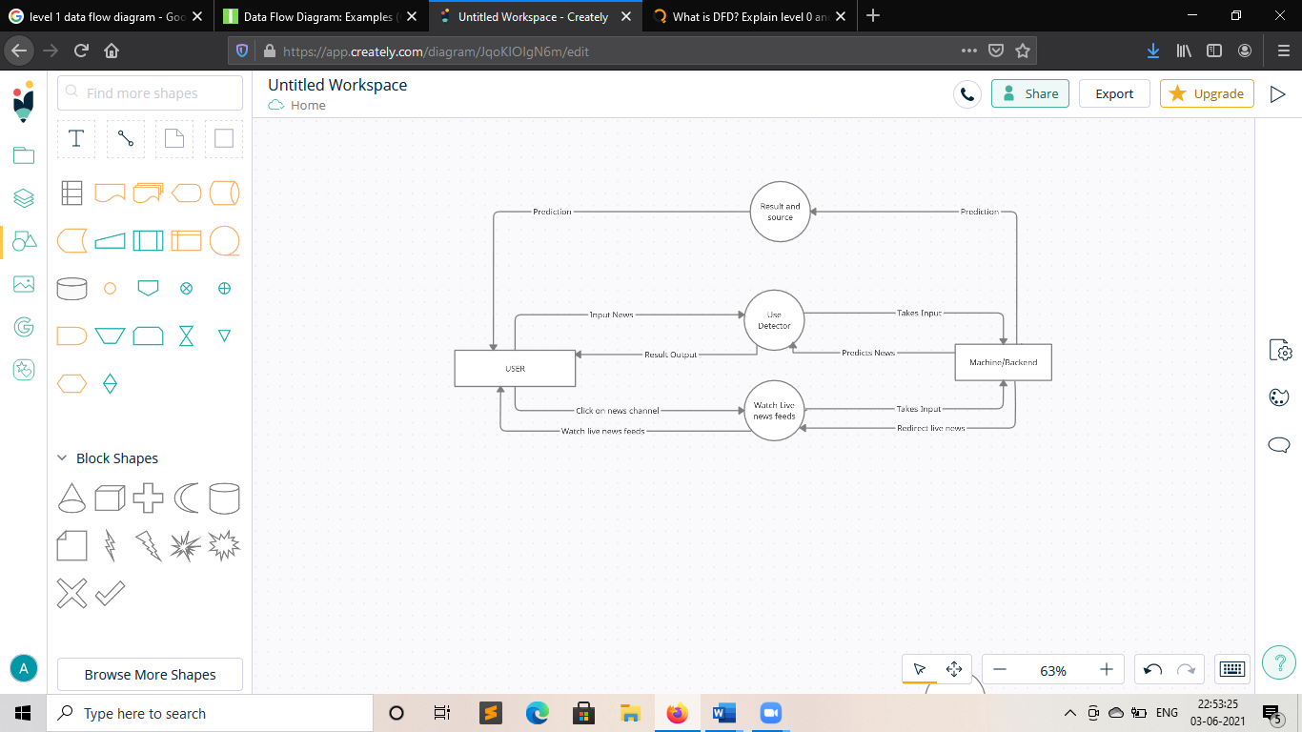
DFD Level 1

Slide 14
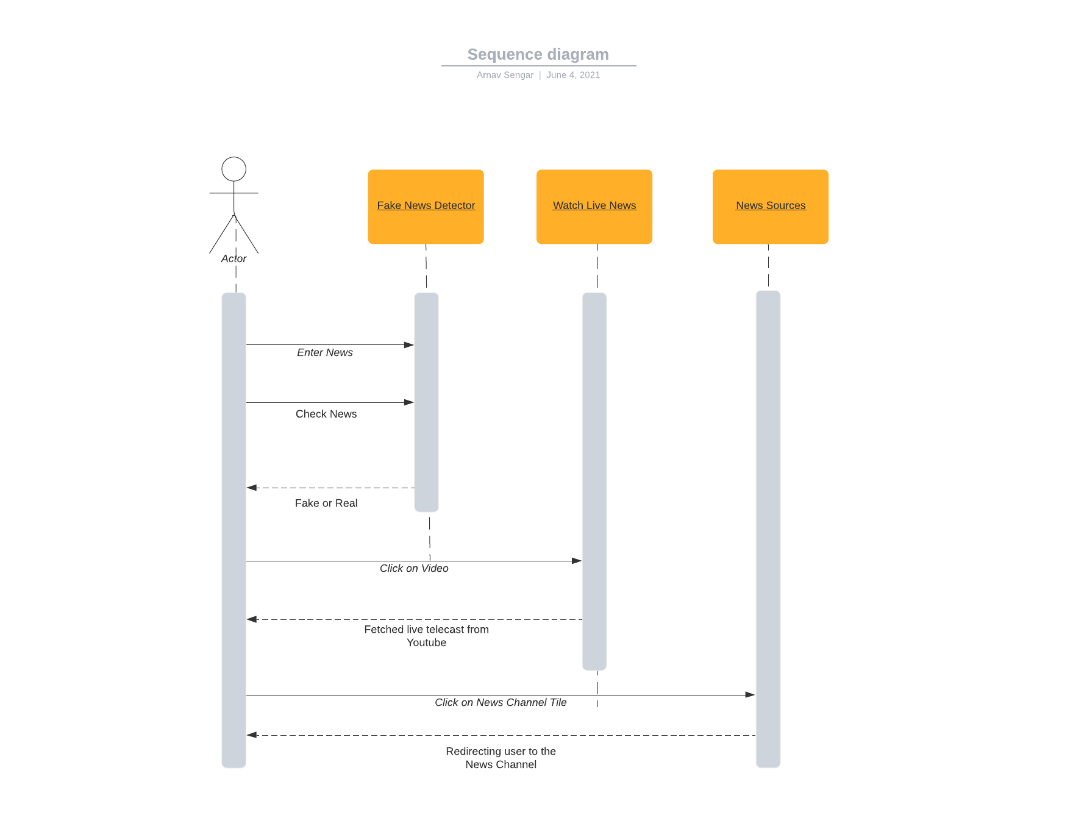

Slide 15
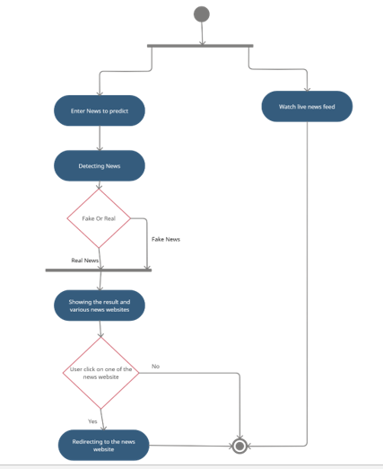

Slide 16
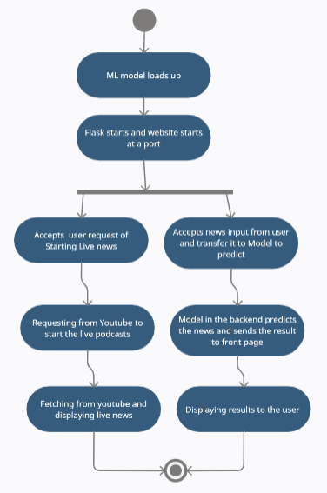

Slide 17
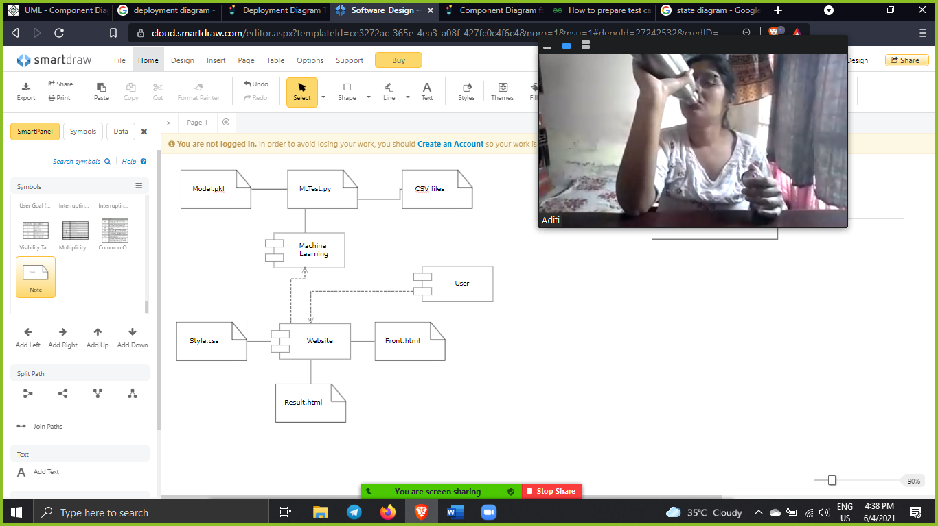
Component Diagram

Slide 18
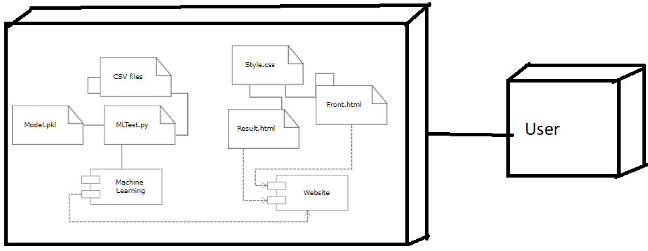
Deployment Diagram

Slide 19
REQUIREMENT ANALYSIS
We performed requirement elicitation using the Survey method. For Survey, a set of questions is given to targeted audience to quantify their thoughts.
After collecting the responses from them, data is analyzed to identify the area of interest of stakeholders. We performed Close Ended Survey method which includes a predefined set of answers for all the questions and the respondent has to choose from those answers.
Following the ideal approach to this technique that is by making a basic Google Form and offering it to the correct individuals, we found the following result.

Slide 20
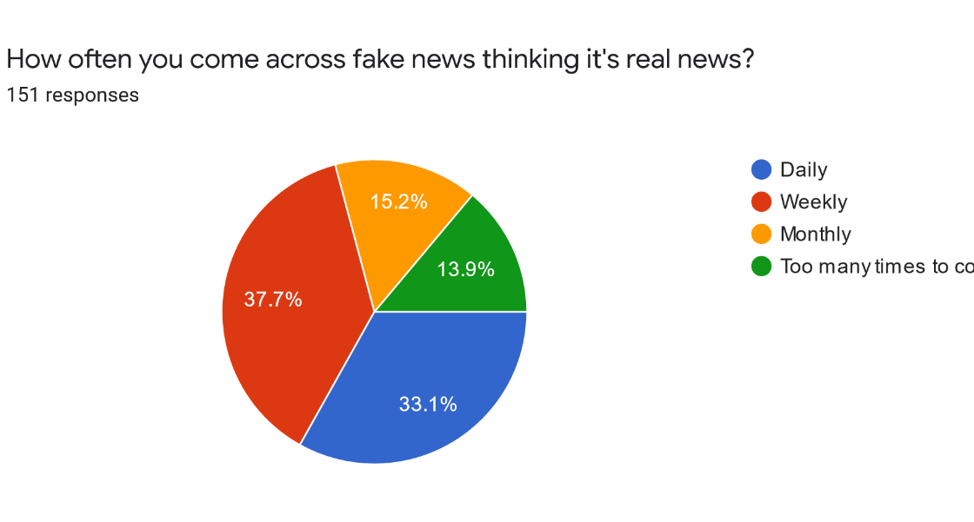

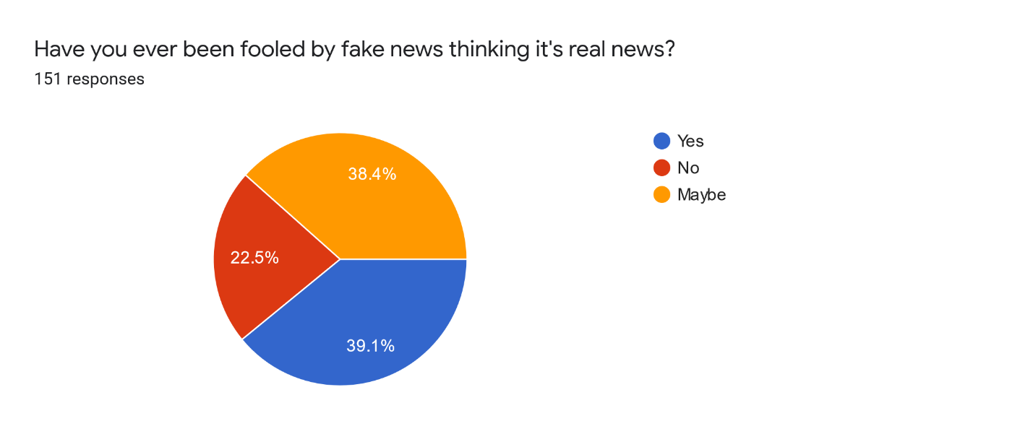
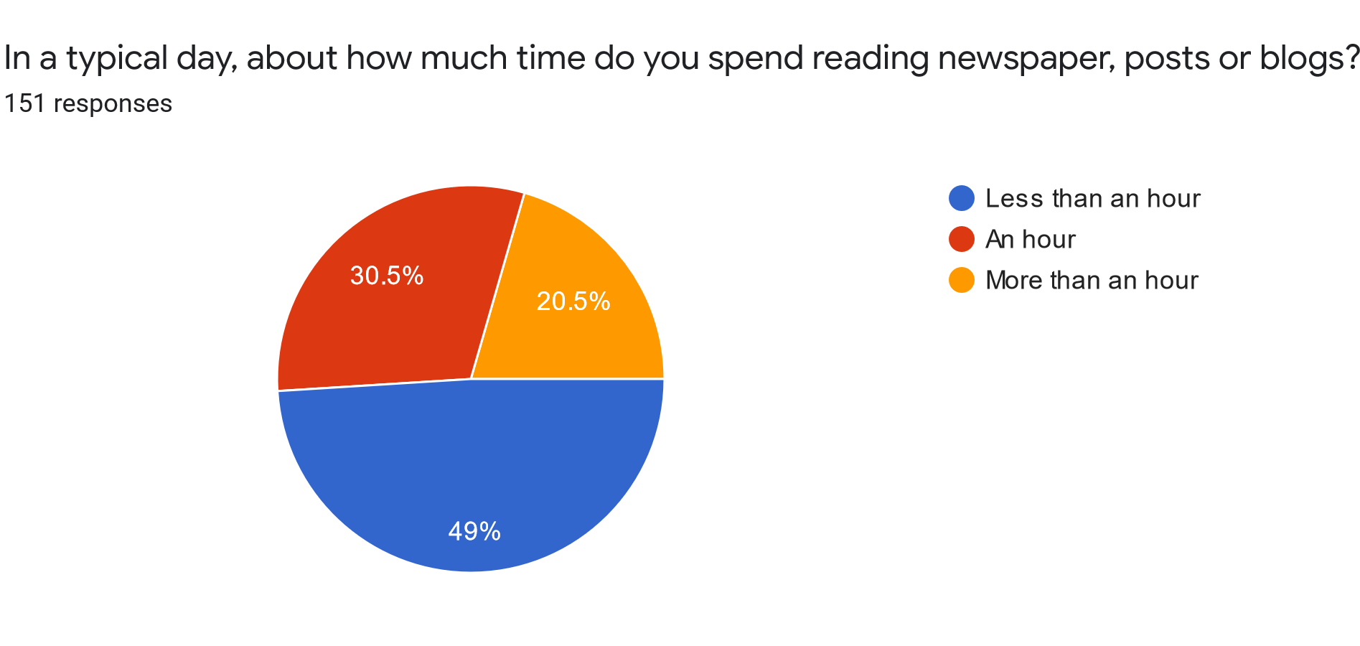
ONLINE SURVEY

Slide 21
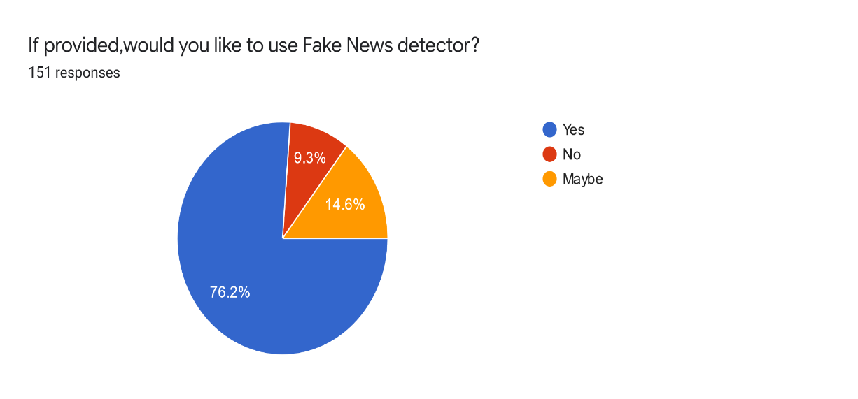
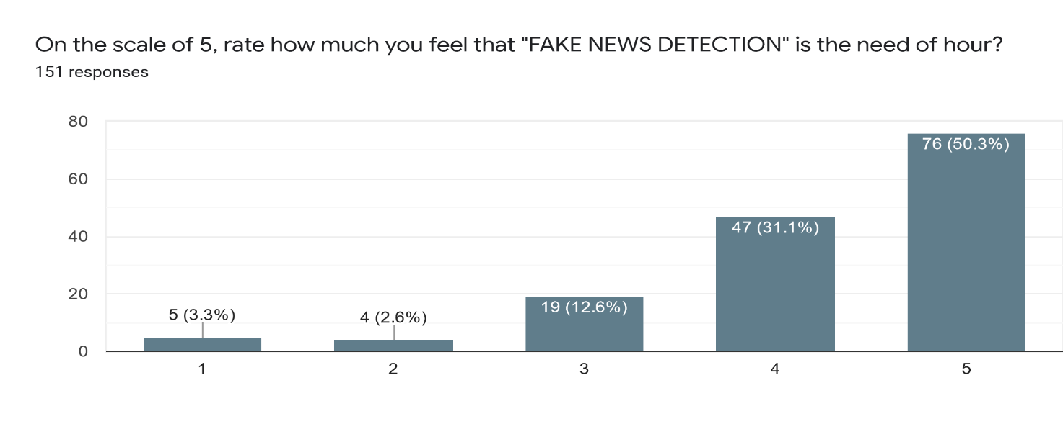
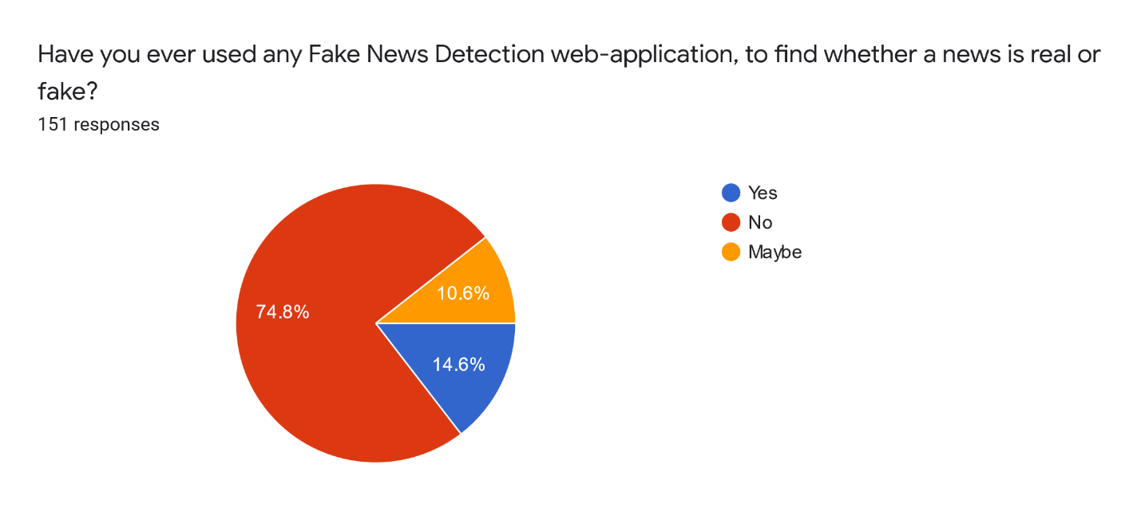
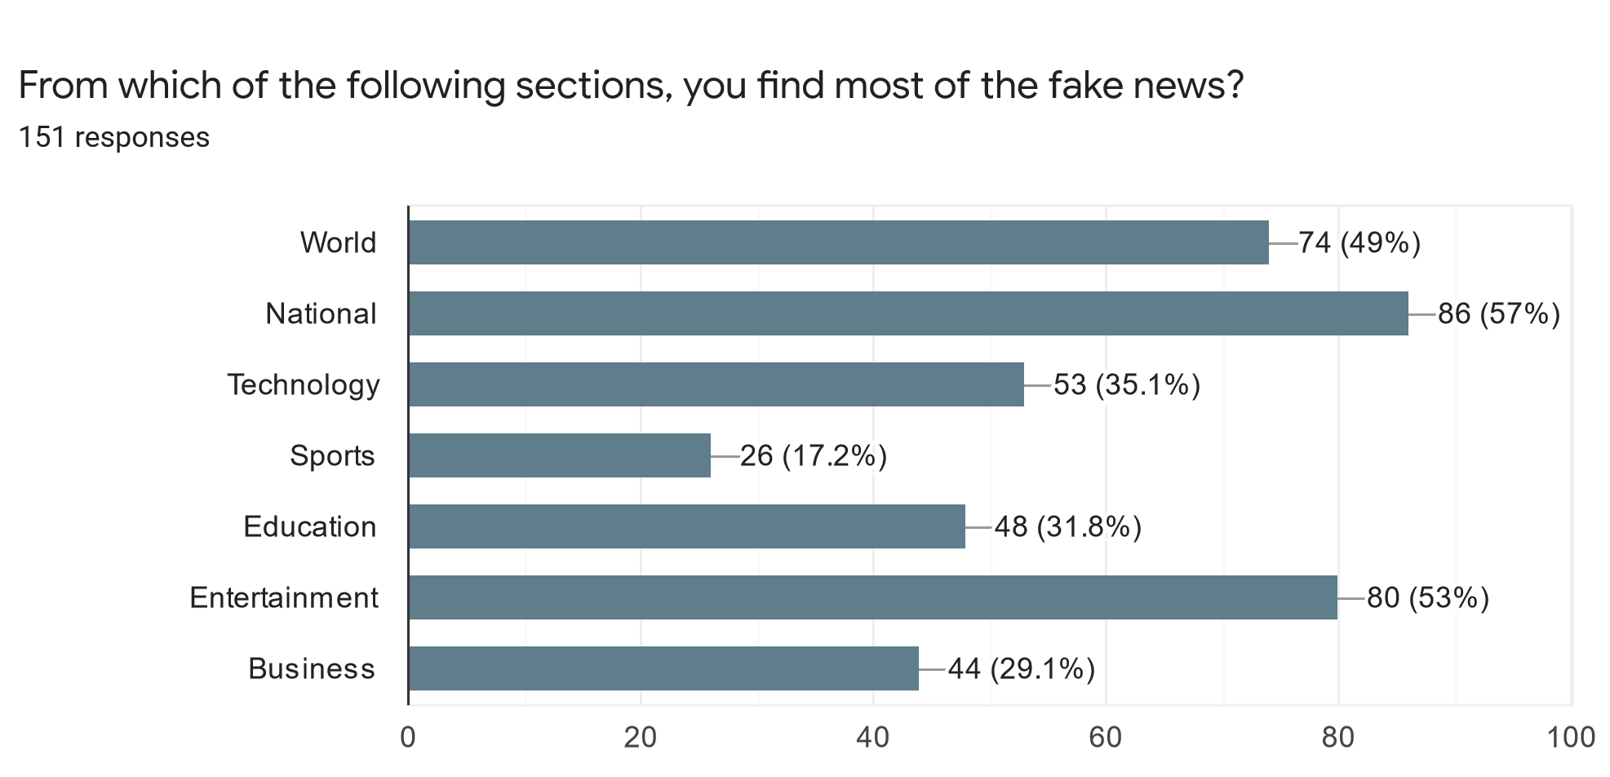
ONLINE SURVEY

Slide 22
TESTING
We will test two components of our project which are:
Machine Learning Model
Front End
1. Machine Learning Model Testing: We tested out machine learning model with different sets of data .
2. Front End Testing: We implemented Testing on our Frontend using the review method:
We gave some users our front end and give us feedback.
We got the feedback that it basic and boring.
We made some changes and added some additional features to out front end.
Then we again gave it to some users and this time we got better feedback that our webpages looking more diligent and additional features are really helpful.

Slide 23
TESTING
Test case Id | Test case Objective | Steps | Input Data | Expected Output | Actual Output | Status
Tc01 | To test our ml model with self generated testing data. | Input data in the textbox and let the model predict. | n number of fake and real news. | 95-100% accuracy | 98.67% accurate. | PASS
Tc02 | To test our ml model with current news from the internet. | Take data from a news website and paste in the textbox. | 10 Real News. | All 10 news are real. | 8 of them were detected real rest 2 fake. | PASS
Tc03 | To test our ml model with short amount of data and of different languages. | Take data from internet and paste it. | 10 real news, 10 fake news. | 50% accuracy as we didn’t train our model with diff languages. | 0% accurate. | FAIL
Tc04 | To test our ml model with short news data as we have trained the model more now. | Take data from internet and paste it. | 10 real news, 10 fake news. | 70-100% accuracy | 70% accurate. | PASS

Slide 24
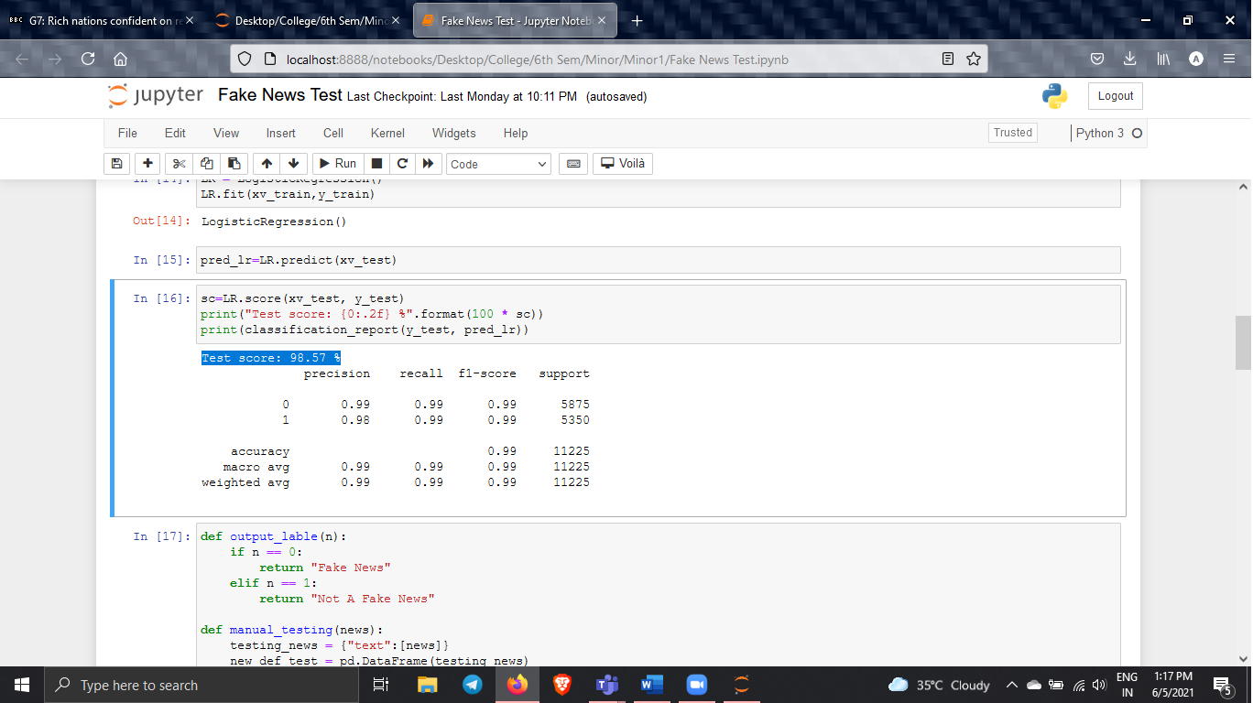
TESTING
Machine Learning Testing-I

Slide 25
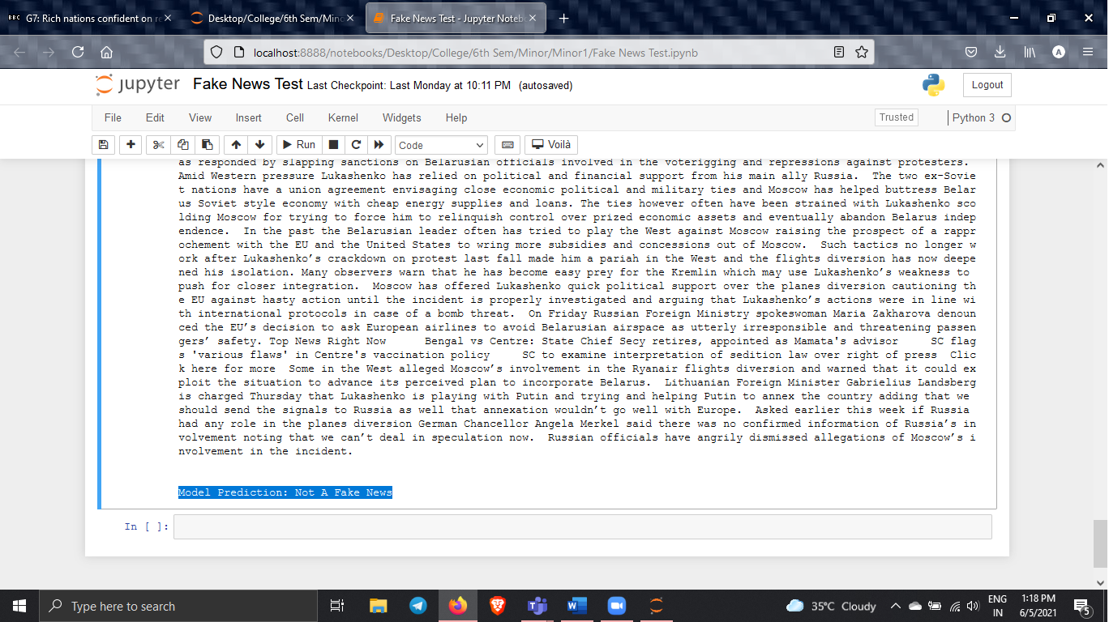
TESTING
Machine Learning Testing-II

Slide 26
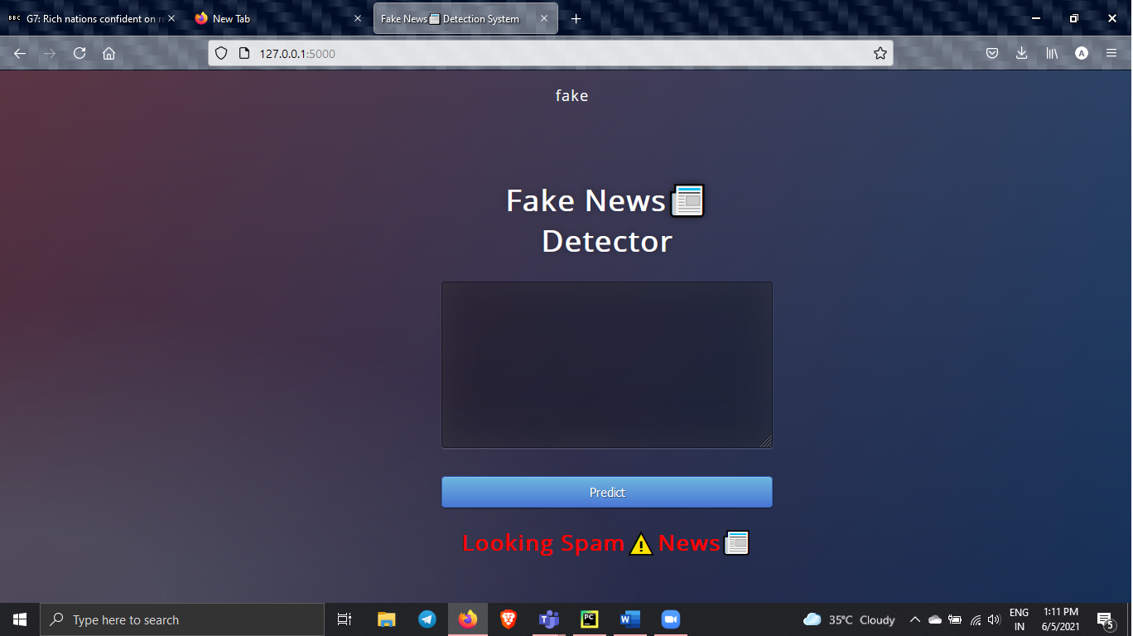
IMPLEMENTATION
Front End Testing-Initial Implementation

Slide 27
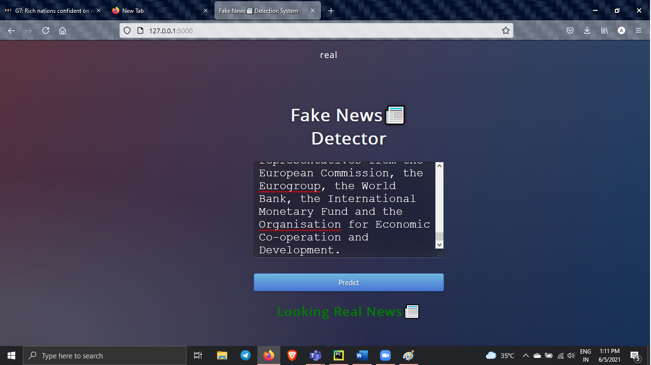
IMPLEMENTATION
Front End Testing-Initial Implementation

Slide 28
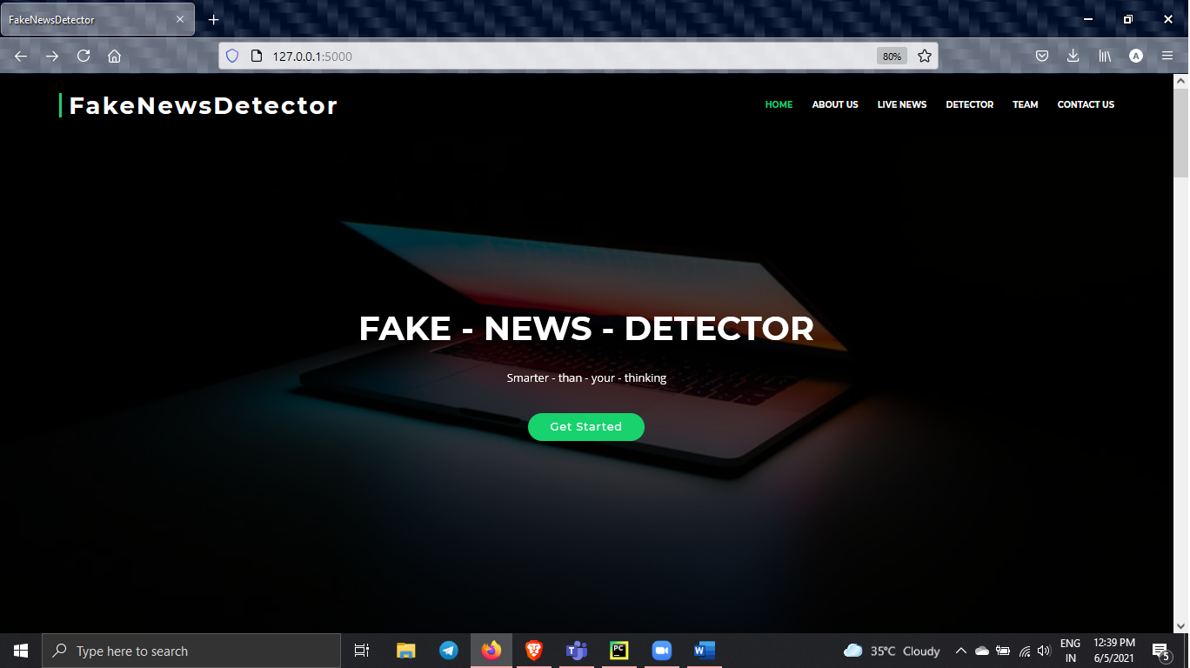
IMPLEMENTATION
Front End Testing-Final Implementation

Slide 29
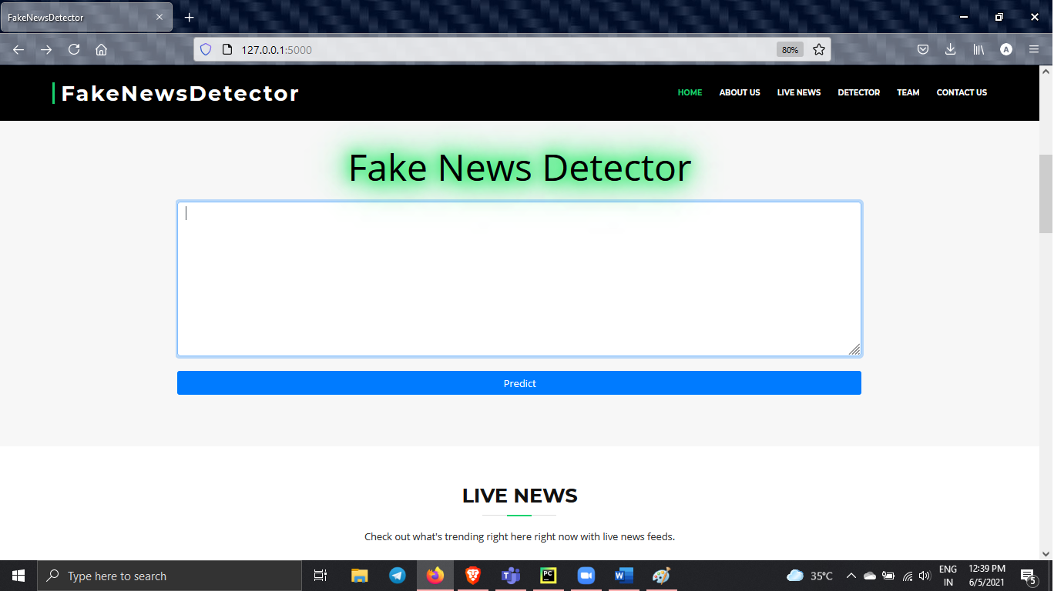
IMPLEMENTATION
Front End Testing-Final Implementation

Slide 30
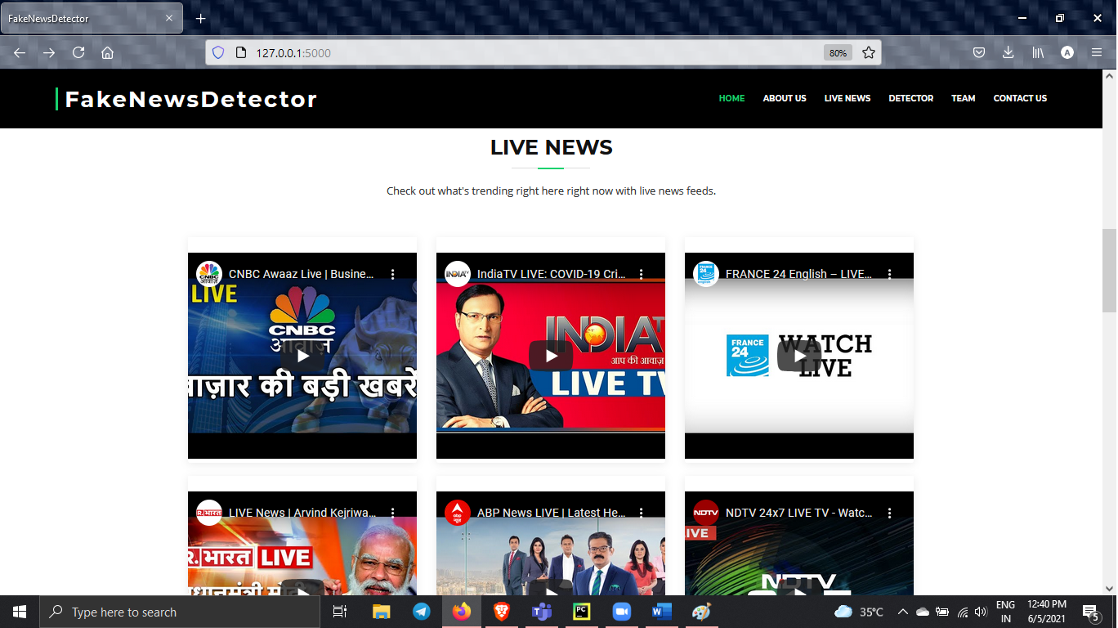
IMPLEMENTATION
Front End Testing-Final Implementation

Slide 31

Implementation

Slide 32

IMPLEMENTATION
Front End Testing-Final Implementation

Slide 33
Conclusion
This was our project about Fake News detection through machine learning. Our mission is to find problems which come in daily life and to solve them through machine learning and Ai.
Our vision is to make our machines self automated for things like this, detecting fake news . To produce more and more automated projects and to implement them directly into the OS to make them fully independent and also user wont need to go somewhere else to use them.

Slide 34
Conclusion
Limitation of Project:
Limitations of our project are obvious as it is the first step towards fake news detection using machine learning.
Fake news usually spreads on mobile phone, and we only have a pc interface for now.
Very few people will come to the pc website after looking the news on mobile phone.
Language is a very big barrier as for now our machine has learned only with English language data.
People needs a more efficient way to check if the news is fake or not.
We have trained out data as good as possible but with new cases happen every day in this world our ML model needs to be trained frequently.
Future Enhancement:
Main goal of using Machine Learning for using Fake news detection is that any machine any device could itself automatically detect a fake news as soon as possible it is shared or sensed.
Implementing this inside an app.
Collecting data of different languages and training our model more and more with that data, so that it can work and detect news of different languages.
Collecting fresh data from users too, to train our model more and more.

Slide 35
THANK YOU

